Slide 1
Mother and Baby homes
Junior Cycle Civic, Social and Political Education (CSPE)
Unit 2

Slide 2
Unit 2: Outline
Slide | Activity No | Activity Name | Description
3 | 1 | “…close to home…” | Introduction/refresher on human rights | Case study of one woman’s experience in a Mother and Baby home (teacher input, video clip, whole class discussion)
4 | 2 | Leaving home | Exit pathways for children leaving Mother and Baby homes (teacher input)
5 | 3 | “You see at the time…” | Case study on the impact on a mother of the birth and adoption of her child (video clip, pair work, whole class discussion)
6 | 4 | UNCRC | United Nations Convention on the Rights of the Child (pair work)
7 | 5 | Unmet, disrespected, denied | Case study of human rights impact on a person adopted from a Mother and Baby home (video clip, pair work, whole class discussion)
8 | 6 | Name, nationality, identity | Consideration of specific UNCRC rights vis-à-vis people adopted from Mother and Baby homes (individual & pair work, whole class discussion)
10 | 7 | “…so that…”? | Consideration of the importance of learning about Ireland’s historic institutions (think-pair-share, whole class discussion)
11 | 8 | Revisiting our Brave Space | Focus on the connection between the Brave Space Agreement and UNCRC Article 12 (individual work, whole class discussion)
12 | 9 | Baggage from the homes | Reflection (individual work)

Slide 3

Activity 1: “…close to home…”
Where after all, do universal Human Rights begin? In small places, close to home – so close and so small that they cannot be seen on any maps of the world.
Eleanor Roosevelt, member
of the committee responsible
for drafting the Universal
Declaration on Human Rights
(UDHR)
“Clann short film: Philomena Lee and Jane Libberton”
Play from 0.40 – 2.16 mins

Slide 4
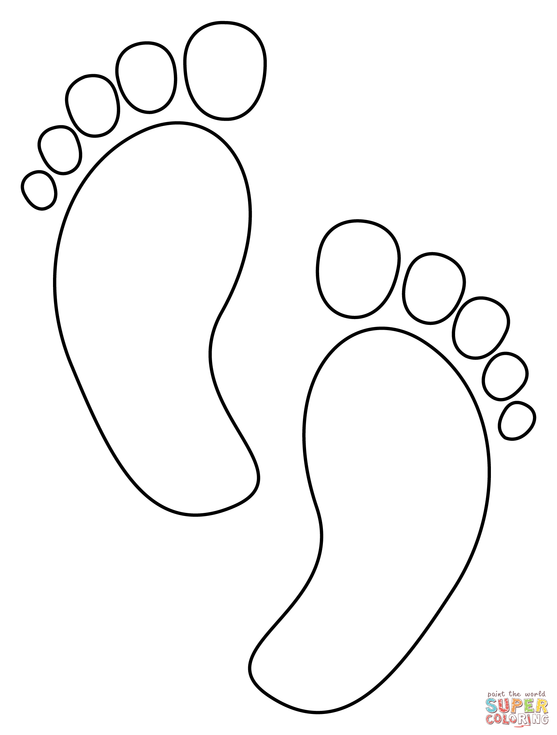
Activity 2: Leaving home
home
Left with mothers
died
Industrial schools
Boarded out
Adopted (il/legally)

Slide 5
Activity 3: “You see at the time…”
What emotions did Philomena associate with the birth of her son?
Why do you think that she felt this way?
What was the impact
of these emotions on
Philomena’s life?
“Clann short film: Philomena Lee and Jane Libberton”
Play from 2.16 – 4.30 mins

Slide 6
Activity 4: UNCRC
For copyright reasons the image of the UNICEF’s child-friendly Convention on the Rights of the Child poster cannot be displayed in this editable version of the slides.
Instead, consider accessing the poster via UNICEF Ireland’s website.

Slide 7


Activity 5: unmet, disrespected, denied
UNCRC articles
unmet, disrespected, denied
“Clann short film: Mari Steed”
Article 7
Article 8
NAME AND NATIONALITY
IDENTITY
Play from start to 5.10 mins

Slide 8

Activity 6: Name, nationality, identity
…as difficult as it was, it was a great experience because it did put me in connection with my tribe.
Mari Steed, CLANN video
We cannot truthfully tell our story without knowing our story.
Mari Steed, quoted in O’Donnell, K., O’Rourke, M. & Smith, J. eds. 2022. Redress: Ireland’s Institutions and Transitional Justice. UCD Press: Dublin. p.5-8; CLANN witness statement.

Slide 9
If you are affected by any of the issues in this unit, and need support, come to me after class, talk to a trusted friend or adult and/or contact:
Adoption Rights Alliance: www.facebook.com/AdoptionRightsAllianceIreland/
Barnardos Origins, Post Adoption and Bereavement Services: www.barnardos.ie
Samaritans: www.samaritans.org
Phone: 116 123
Childline: www.childline.ie
Phone: 1800 66 66 66
Jigsaw: www.jigsaw.ie

Slide 10

Activity 7: “…so that…?”
[W]e must teach children the history of this dark chapter in Ireland and keep that memory alive so that...
Mary Harney, quoted in O’Donnell, K., O’Rourke, M. & Smith, J. eds. 2022. Redress: Ireland’s Institutions and Transitional Justice. UCD Press: Dublin. p.6.
it never happens again.
Complete the quote…
Compare and discuss your quote with one other person
Join with another pair, compare and discuss again
Decide whether to merge/edit a quote to share with the class
Present your group’s quote
Article 29
AIMS OF
EDUCATION

Slide 11


Activity 8: Revisiting our Brave Space
SPACE | ★ |  |  |  | 
1. I have been listened to
2. I felt comfortable giving my opinions
3. I felt safe giving my opinion
4. A lot of different voices were included
Article 12
VOICE | ★ |  |  |  | 
1. I got the chance to give my opinions
2. I got enough information to help me give my opinions
3. I got support to have my voice heard
4. I understood what was being discussed
5. I could give my opinions whatever way I wanted
6. I had enough time to talk
RESPECT FOR
CHILDREN’S VIEWS

Slide 12

Activity 9: Baggage from the homes
Imagine a bag especially for your experiences and all that you have learned about the Mother and Baby homes and other historic institutions during these units.
Imagine packing your bag with words, images, symbols representing the knowledge, skills, values and experiences you want to keep.
Imagine putting the things that you want to leave behind (old ideas, misconceptions, attitudes, beliefs or difficult moments) on the ground beside the bag and walking away without them.
Imagine yourself leaving class with this bag on your back.

