Slide 1

Junior Cycle Social, Personal and Health Education
(SPHE)

Slide 2
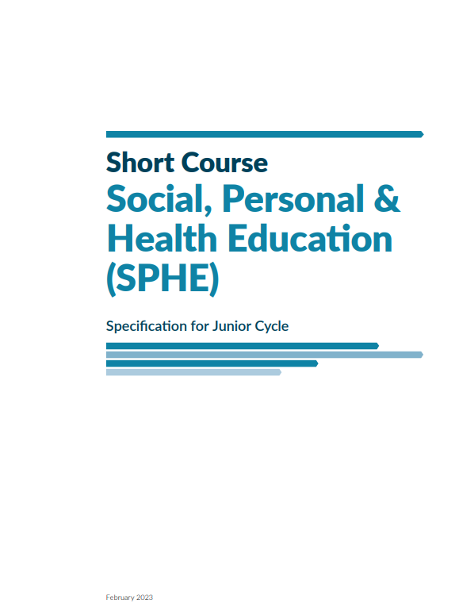
Purpose of this presentation
To explain the context for changes to the Social, Personal and Health Education (SPHE) curriculum
To provide an overview of what’s included in the updated Junior Cyle SPHE curriculum
To sign-post where to go for more information and share your views on further SPHE developments
Why?
What?
What next?

Slide 3
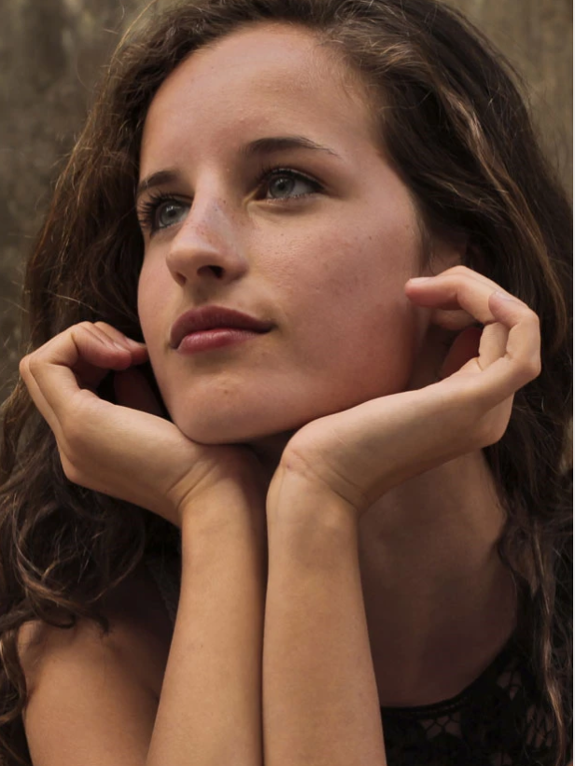
Why change?
the challenges that young people face growing up in Ireland today
the important role that school-based health education programmes can play in supporting young people’s social, emotional and physical wellbeing
national policy supports the development of an updated SPHE curriculum that is inclusive, and age- and stage-appropriate
extensive feedback gathered through consultations with teachers, students and other stakeholders
To see the background papers and reports: https://ncca.ie/en/junior-cycle/curriculum-developments/social-personal-and-health-education-sphe/

Slide 4
Engagement in Junior Cycle SPHE consultations (2021 and 2022)
Feedback via online surveys Parents Teachers Students | 4,353 151 509
Focus groups and other meetings No of participants | 191
Written submissions | 193

Slide 5
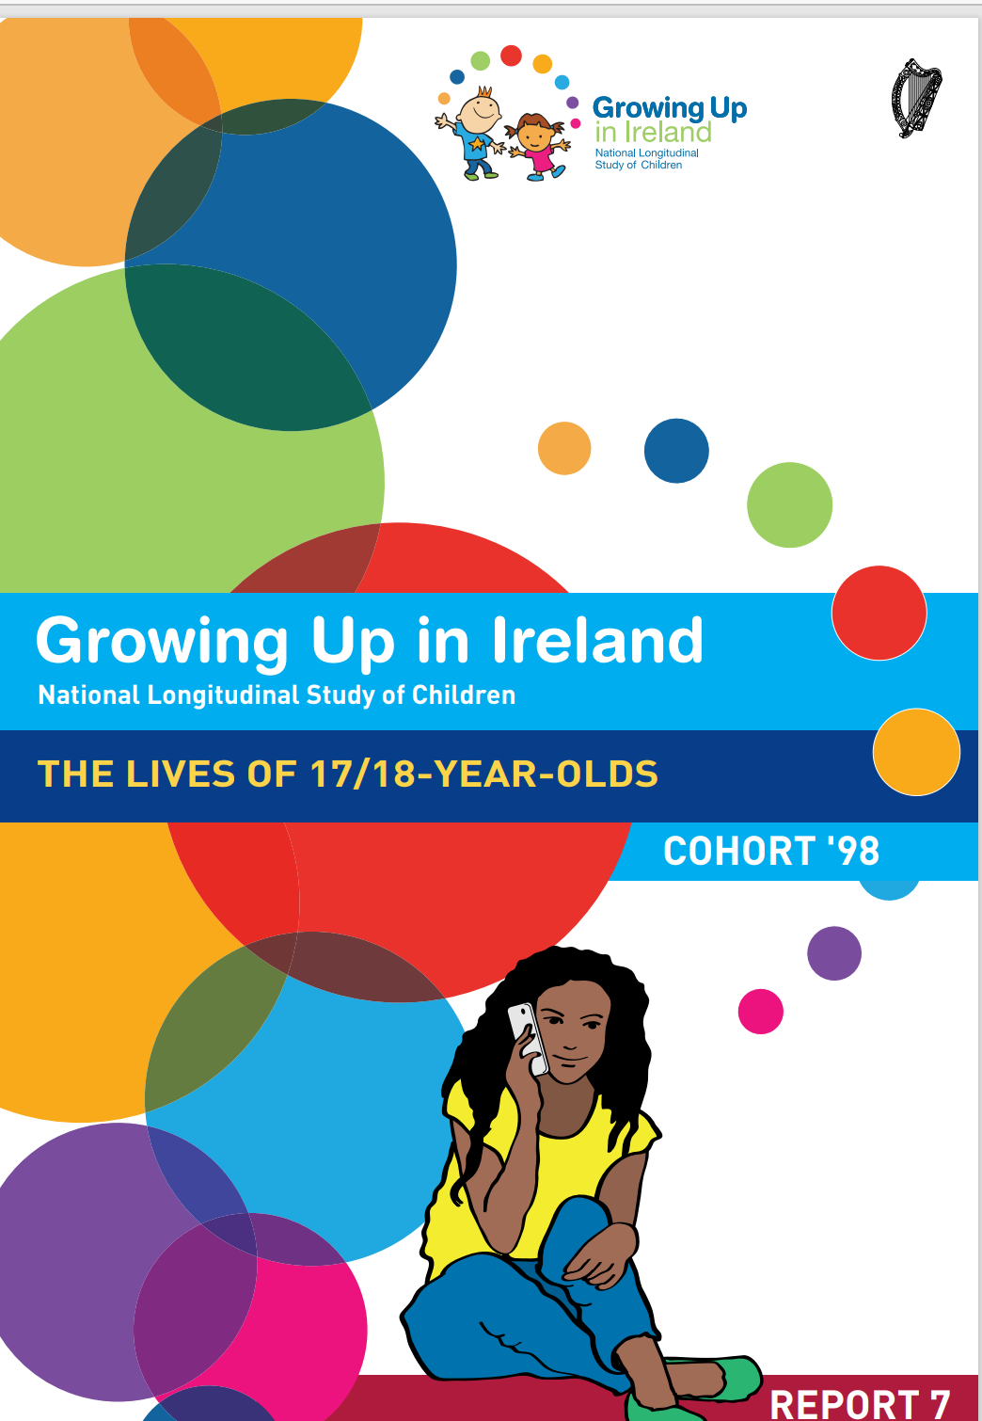
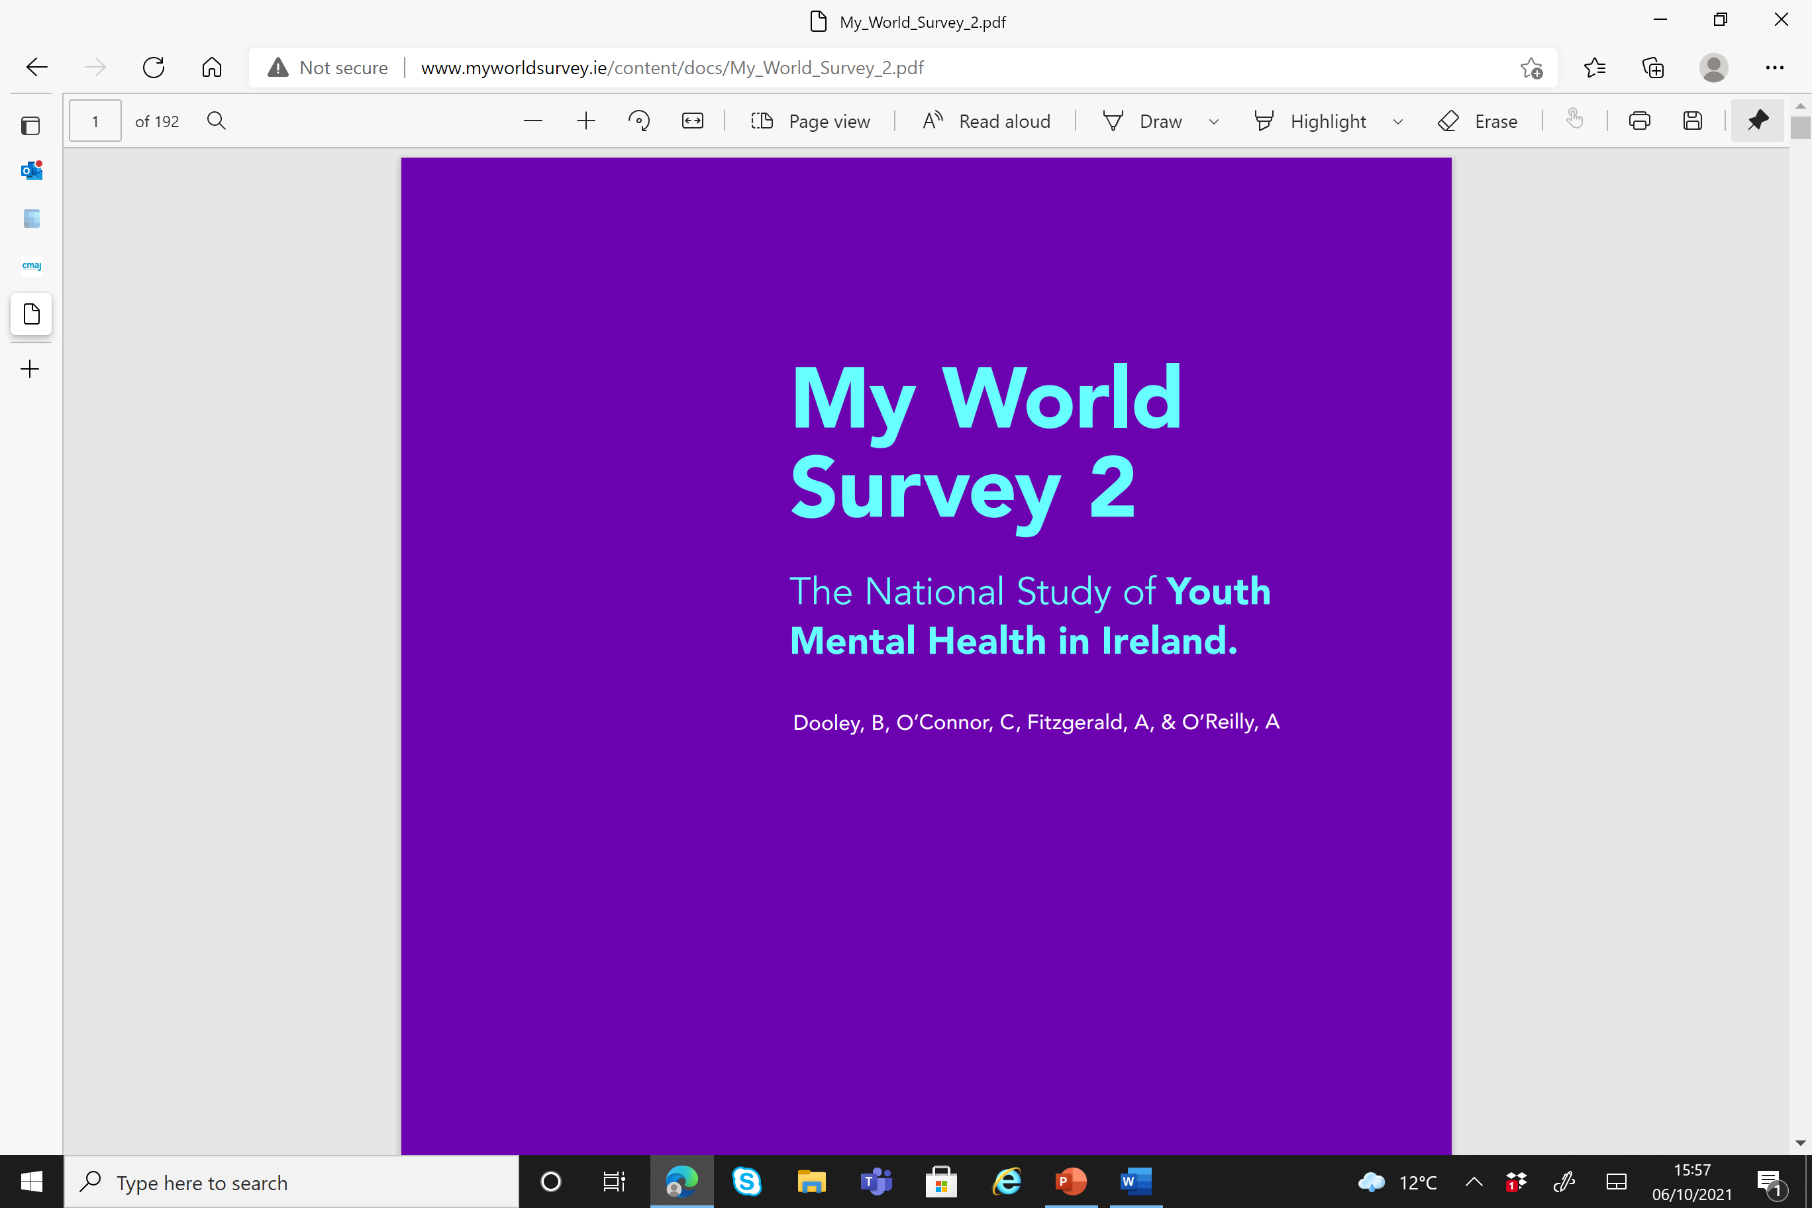
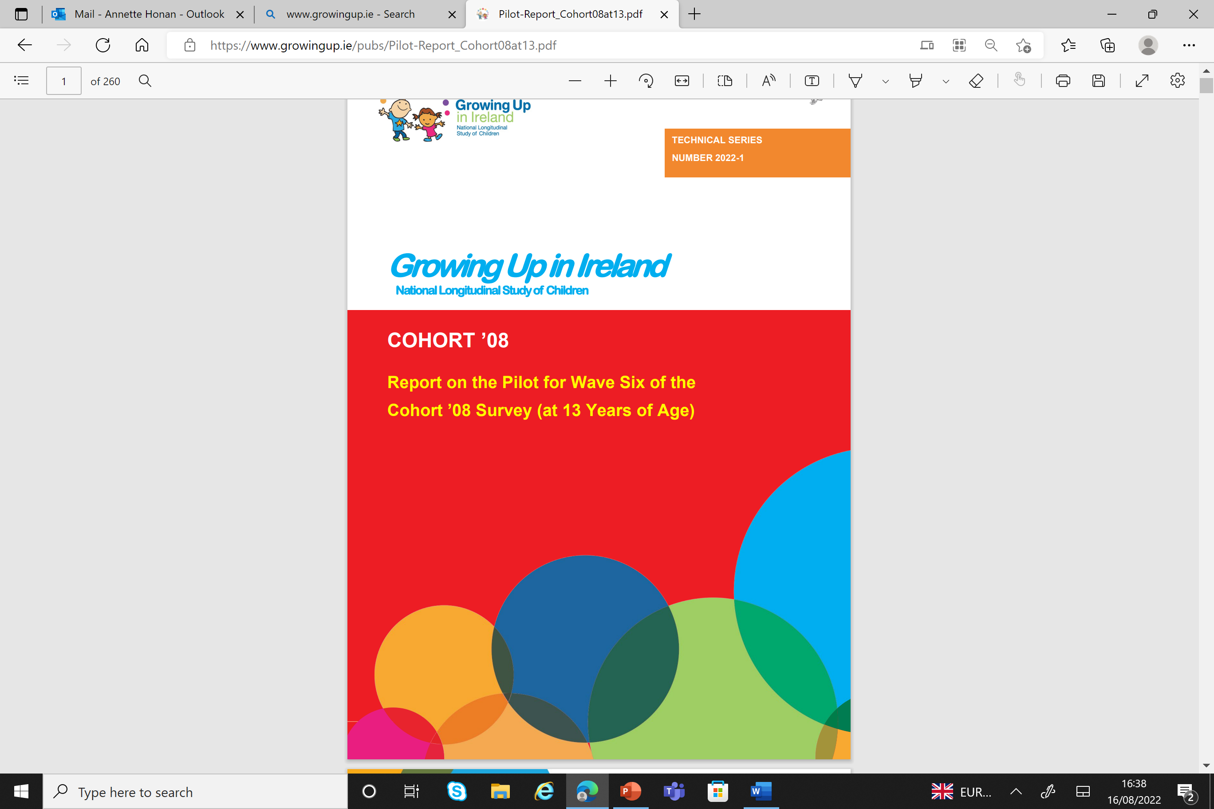
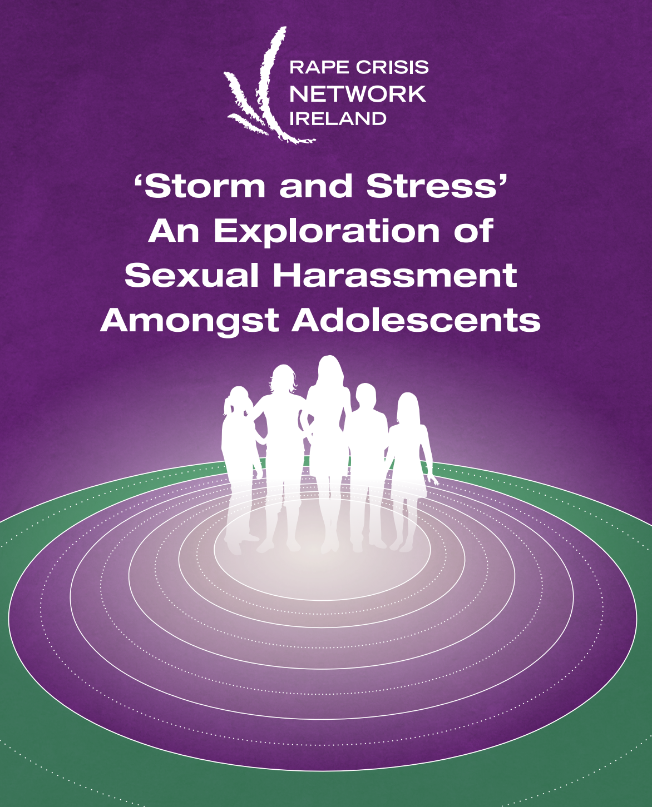
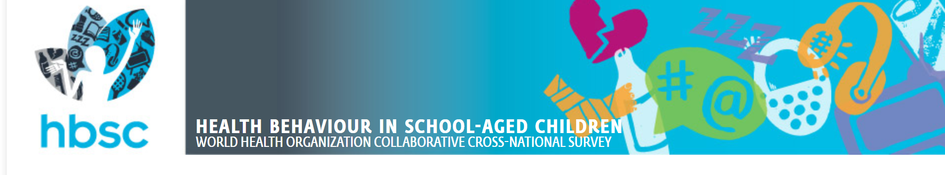
Sample research on adolescents in Ireland today

Slide 6

Some of the challenges addressed in the SPHE curriculum
Increased levels of stress and anxiety among young people
How to build healthy, respectful relationships with peers, friends, family
Managing the online world
Alcohol, smoking and vaping
Sharing of messages and images on social media
An inclusive environment for all students

Slide 7
What’s the aim of the JC SPHE curriculum?
“This course aims to …
build students’ self-awareness and positive self-worth; to develop the knowledge, understanding, skills, dispositions and values that will support them to lead fulfilling and healthy lives; empower them to create, nurture and maintain respectful and loving relationships with self and others; and enhance their capacity to contribute positively to society.”
Updated JC SPHE Specification, pg 5

Slide 8
The updated SPHE short course
Strong focus on building skills
social and emotional skills
skills of critical thinking & ability to question social/cultural norms
health literacy skills
Grounded in values of respect, equality, inclusivity, responsibility, dignity, compassion and empathy

Slide 9
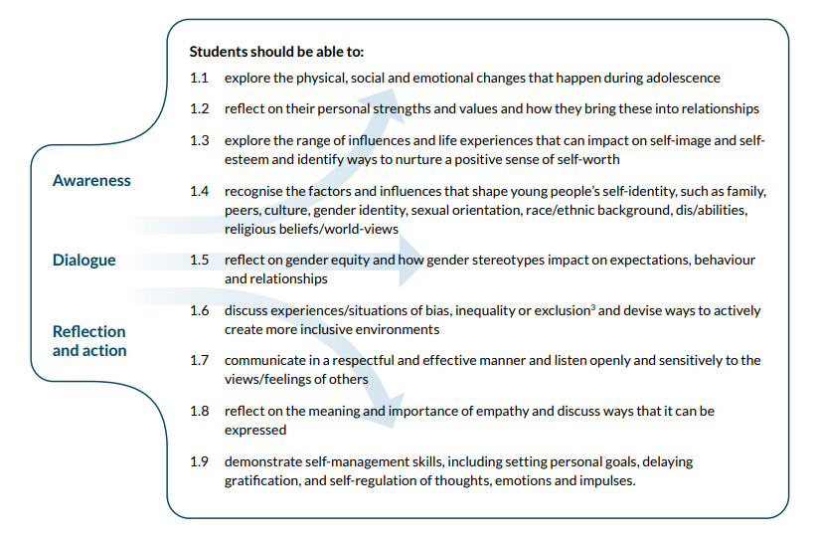

Strand 1: Understanding Myself and Others
Notes:
Strand 1 – Understanding myself and others – is a foundational strand as it focuses on developing self-awareness and self-esteem and building some of the social and emotional skills needed for healthy relationships (communicating, listening, showing empathy). This strand explores the range of influences that impact on self-esteem and self-image and the influences that help shape young people's self -identity.

Slide 10
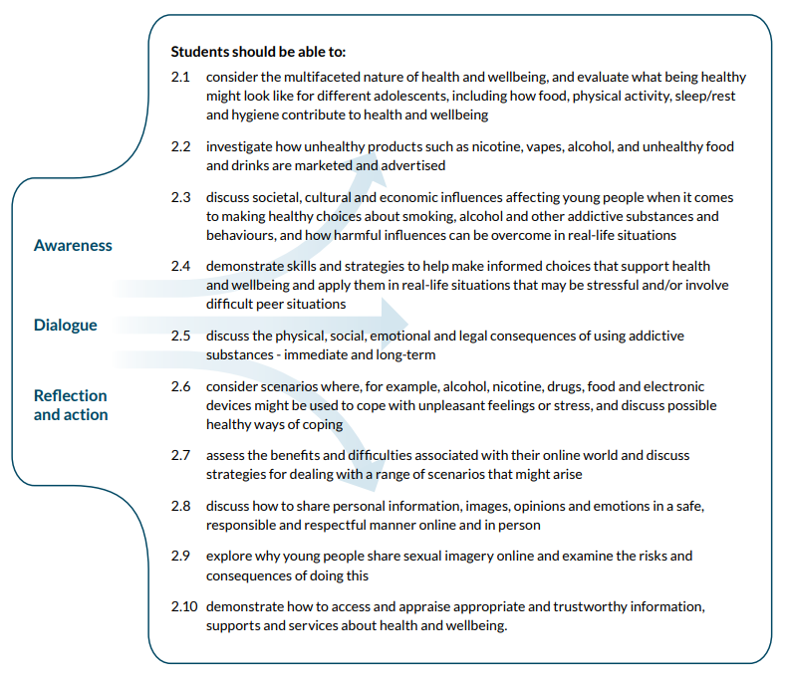
Strand 2: Making Healthy Choices
Notes:
Strand 2 – Making healthy choices – is about helping students to consider how they can make healthy choices and the influences at play – across a range of aspects – food, sleep, alcohol and other addictive substances and behaviours, and of course their online world.

Slide 11
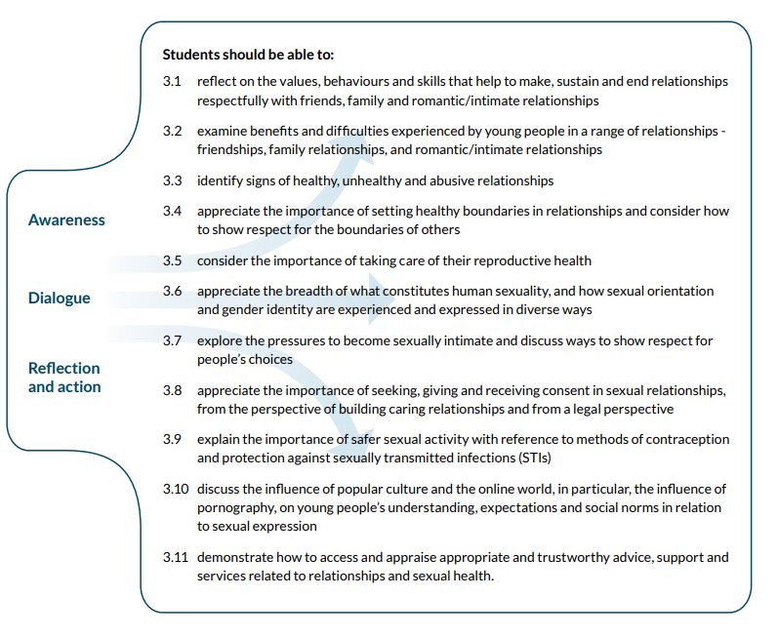
Strand 3: Relationships and Sexuality
Notes:
Strand 3 – Relationships and sexuality –here the key focus is on creating and maintaining healthy and respectful relationships – family relationships, friendships, romantic and intimate relationships and potential sexual relationships in the future. So students would discuss the signs of healthy, unhealthy and abusive relationships, how to set boundaries in relationships and show respect for the boundaries of others, how that links in with an understanding of consent, how to take care of their reproductive health, methods of contraception and protection from STIs, etc There is strong focus on responsible decision making and respectful relationships as well as examining some of the pressures on young people to become sexually active. Mention 3.10 (porn LO)

Slide 12
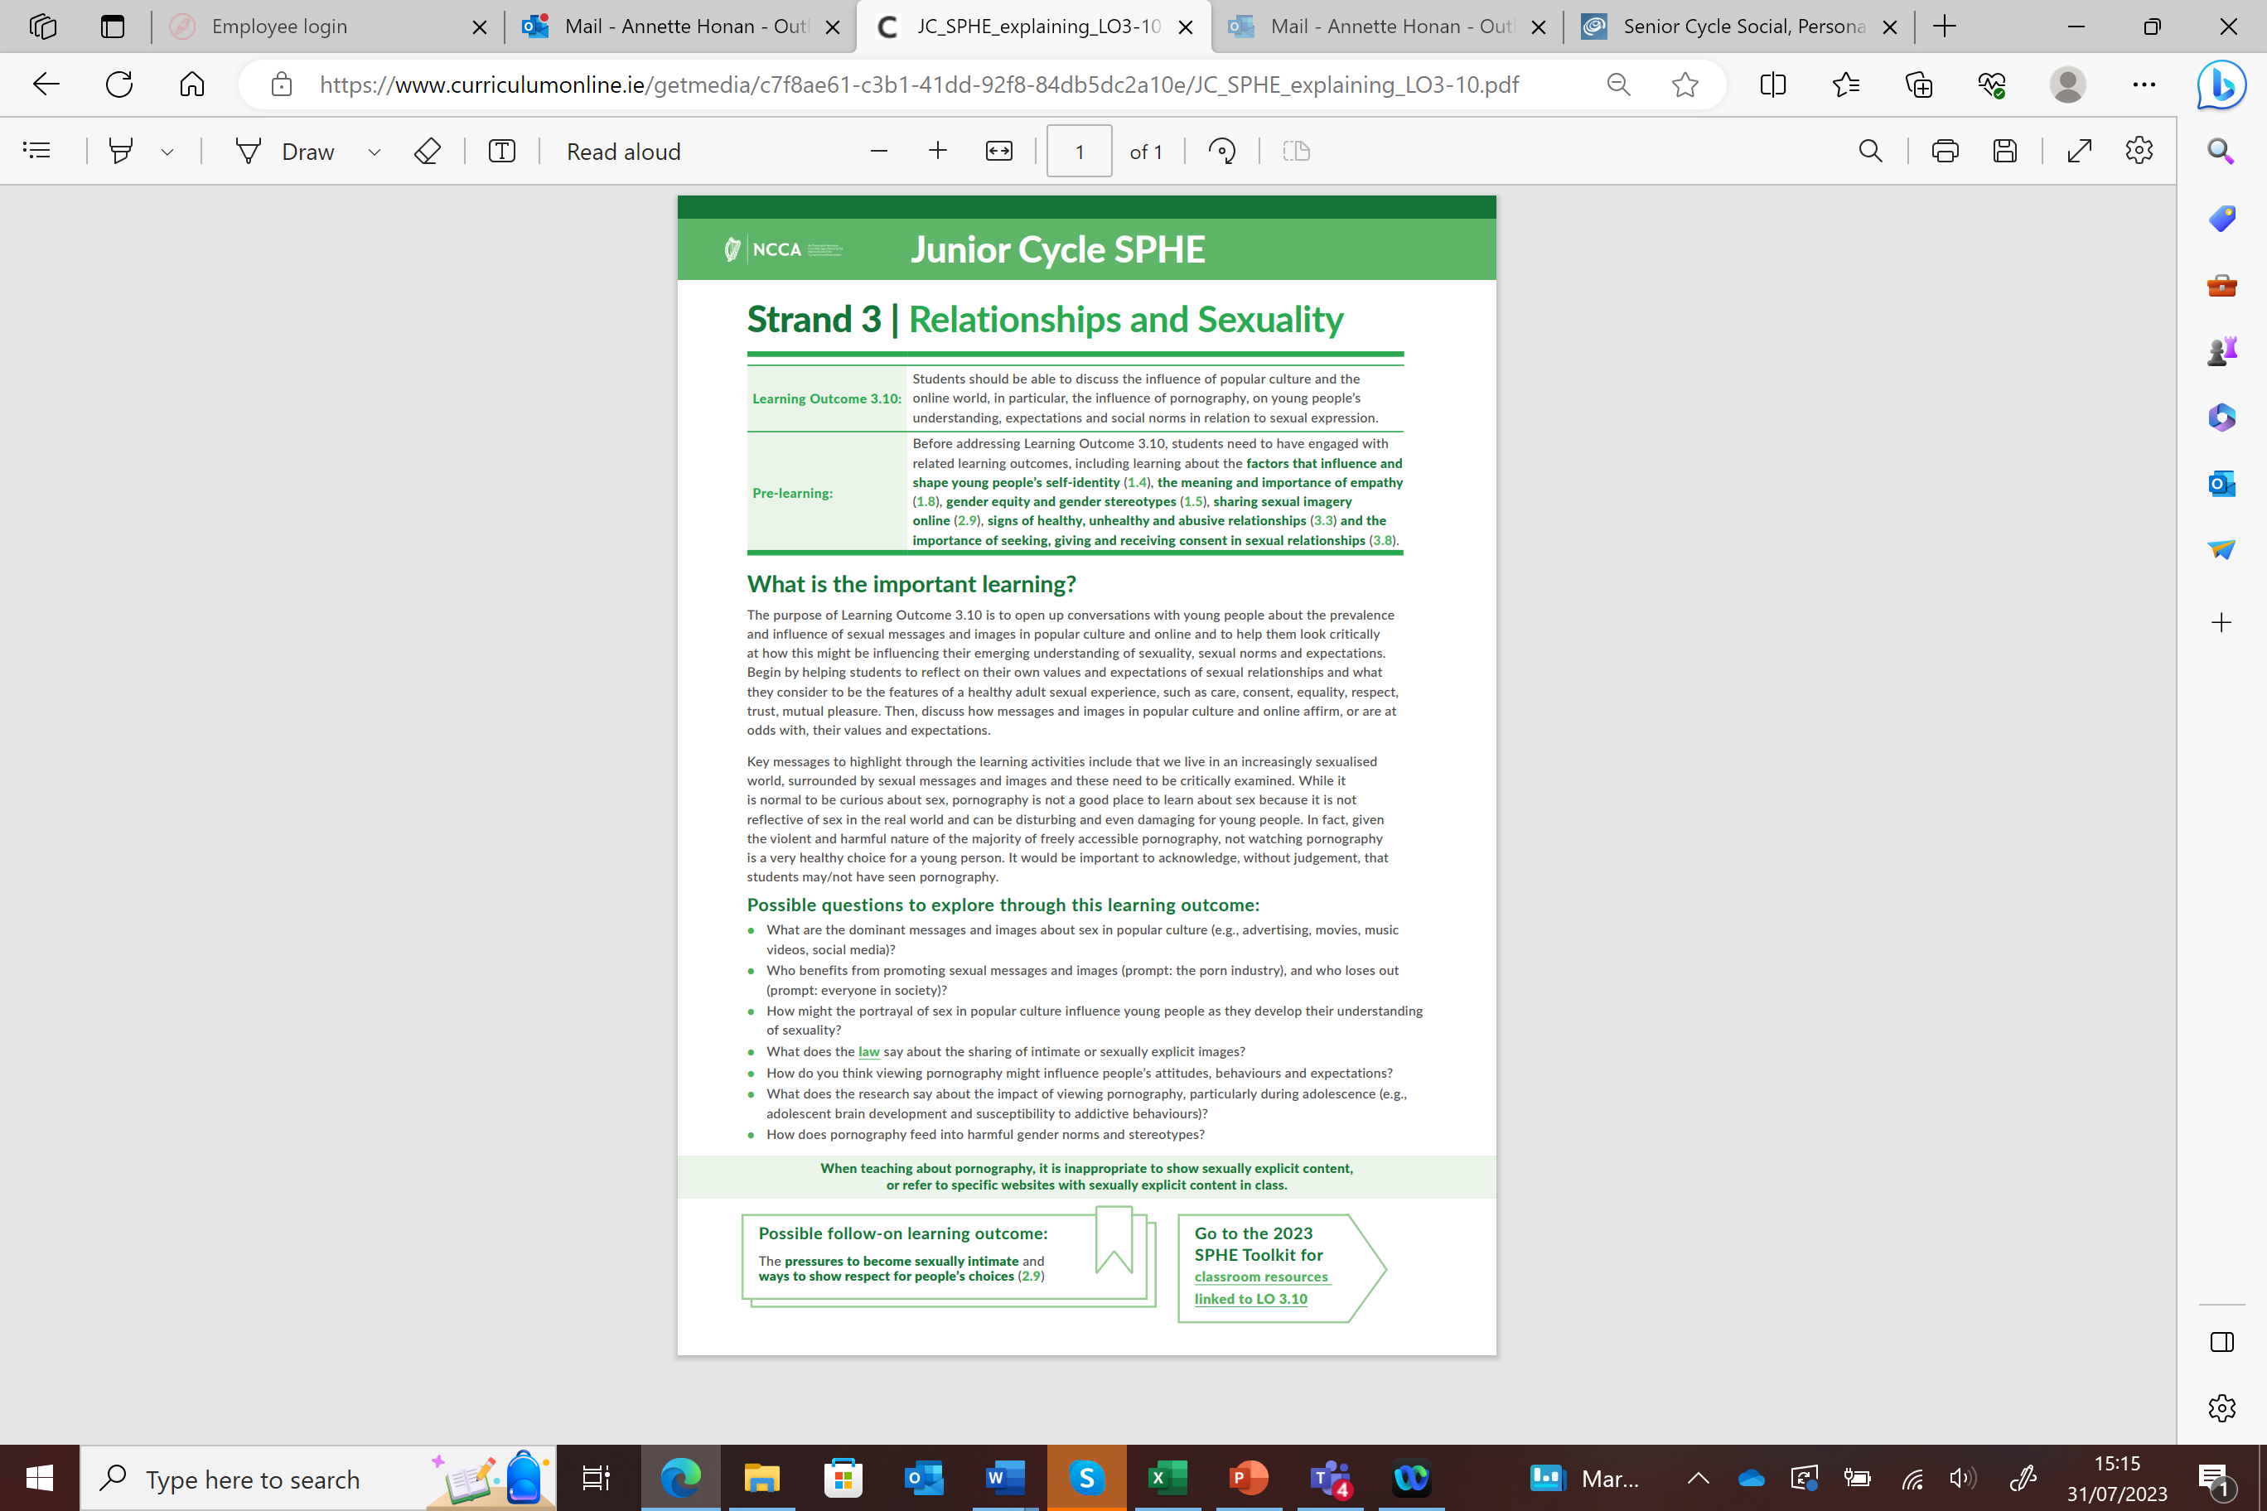
Learning Outcome 3.10, which mentions pornography has been the focus of much media attention.
What does Learning Outcome 3.10 say?
'Students should be able to discuss the influence of popular culture and the online world, in particular, the influence of pornography, on young people’s understanding, expectations and social norms in relation to sexual expression'

Slide 13
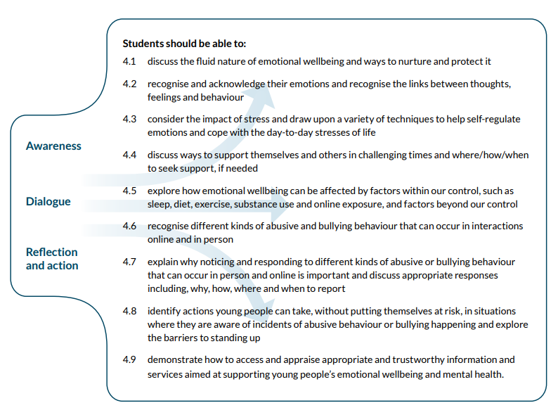
Strand 4: Emotional Wellbeing

Slide 14
Parents and schools working together
Conversations between parents and their children are really important but not always easy!
By age 17 the most common source of information about sex and relationships is friends (followed by the internet)
Research affirms the positive impact that school-based programmes can have when delivered in partnership with parents

Slide 15
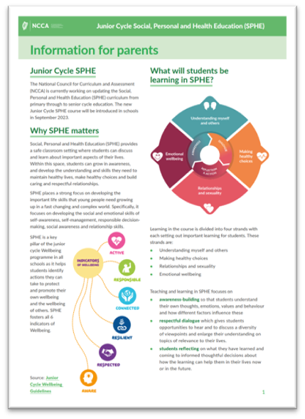
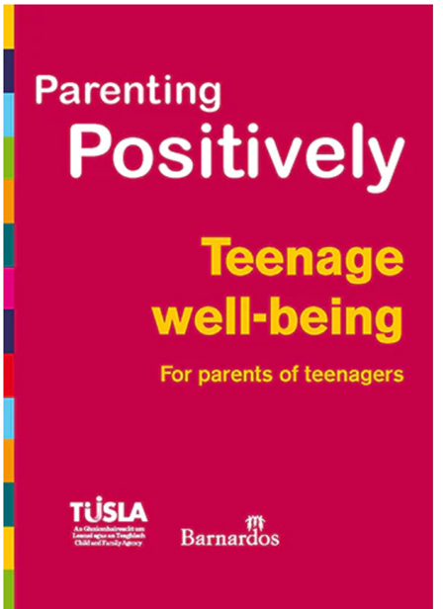
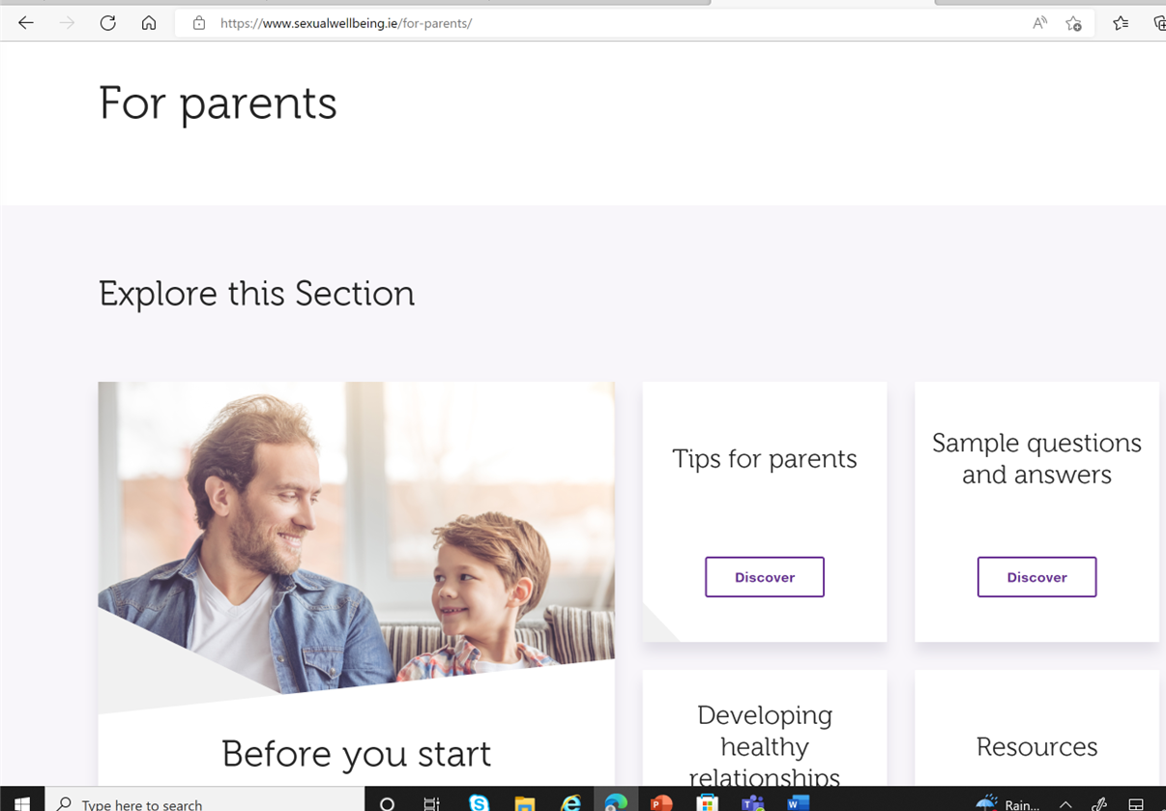
Sample resources for parents
HSE Website - www.sexualwellbeing.ie
www.ncca.ie
www. barnardos.ie/resources/parents

Slide 16
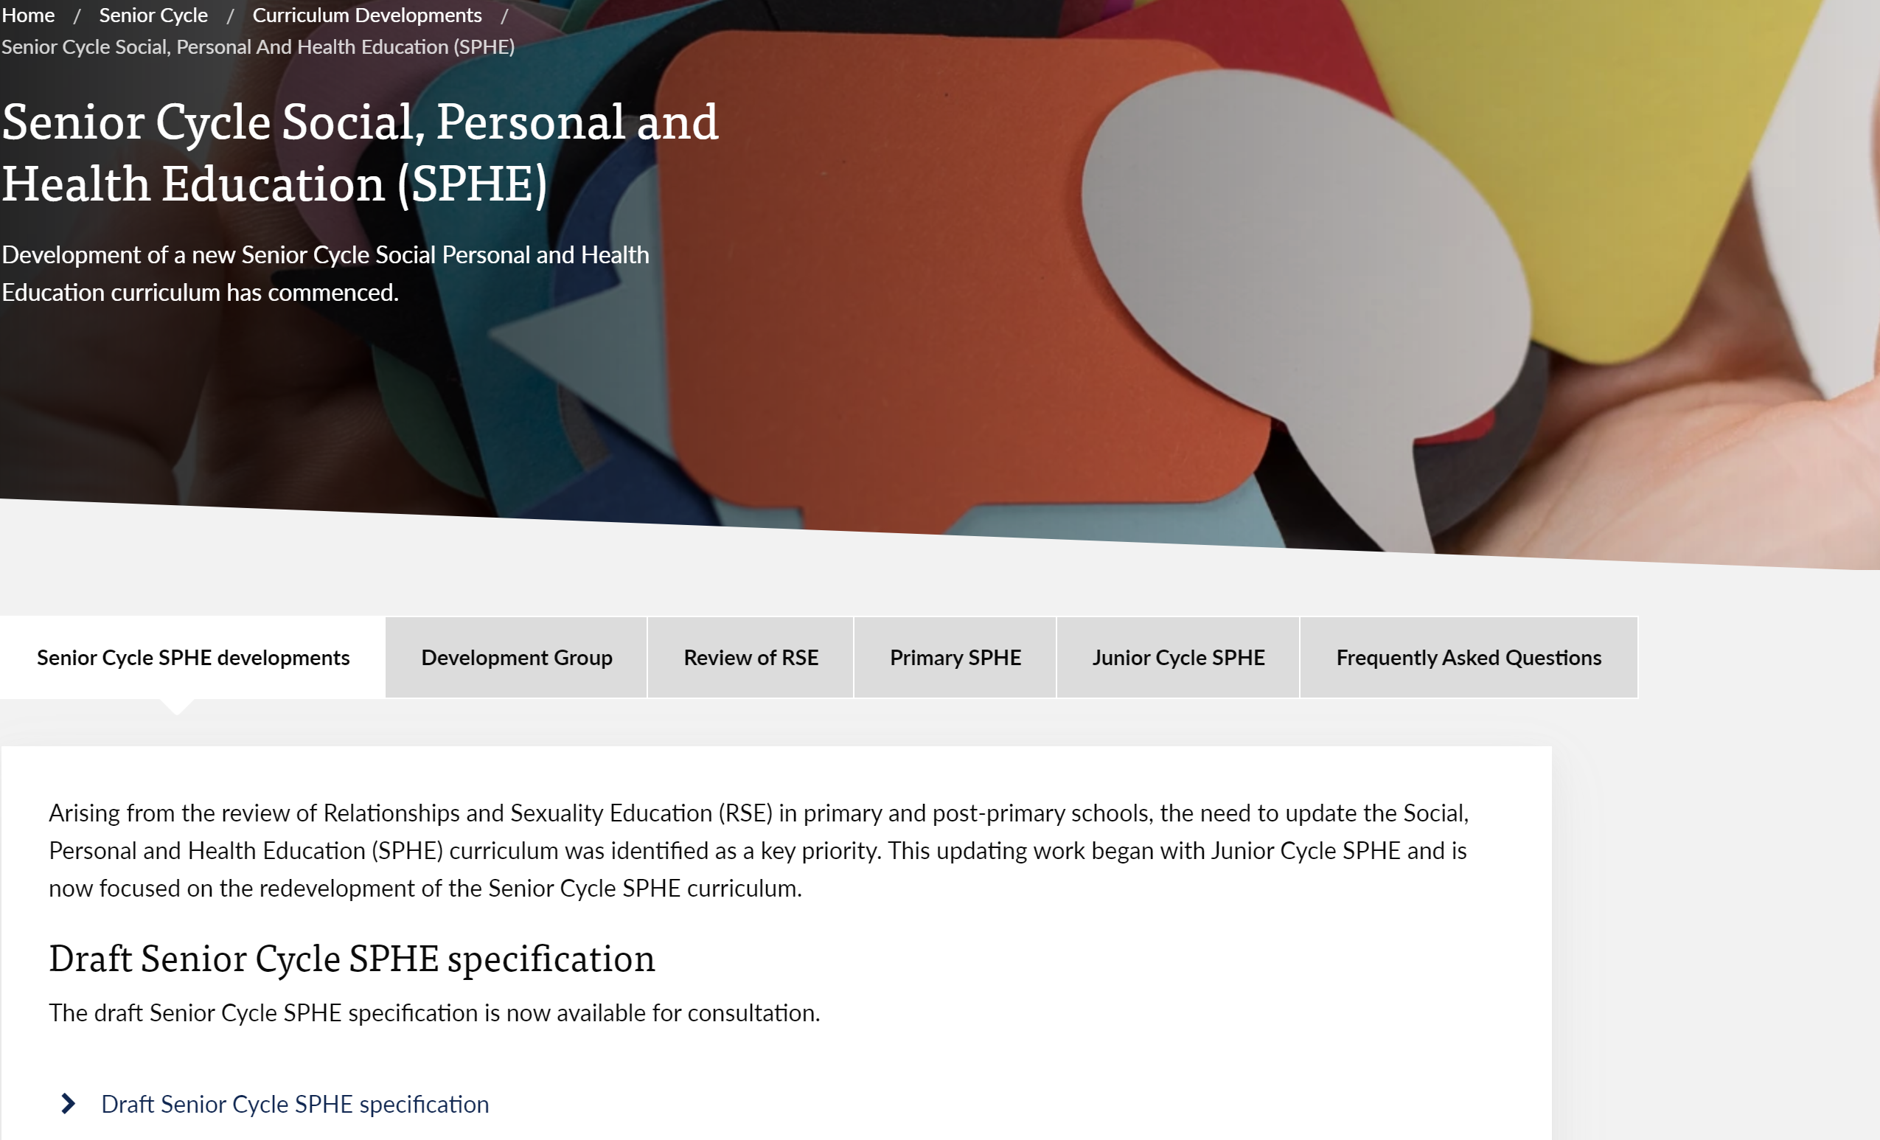
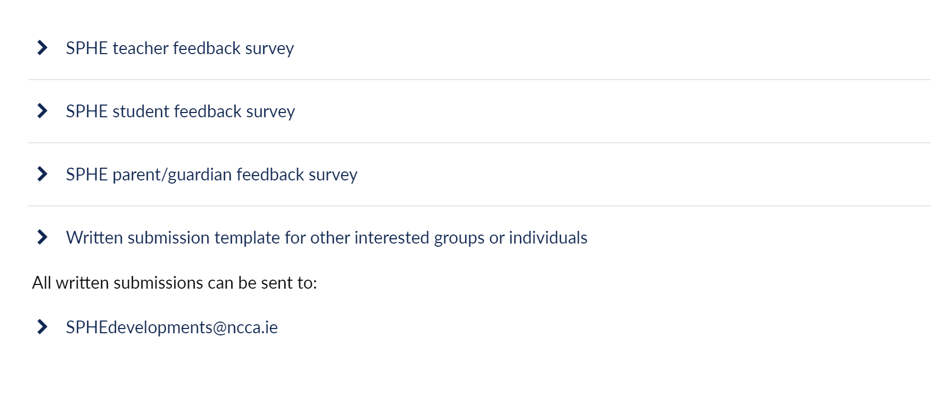
Have your say in shaping curriculum developments in Senior Cycle SPHE
Public consultation on updated Senior Cycle SPHE specification:
Open until Oct 18th
Go to www.ncca.ie
www.ncca.ie

Slide 17
Go raibh míle maith agaibh

